Slide 1
INTRODUCTION TO COMPUTING
Course Code: CCINCOM/L
More Asymptotic Notations, Recurrence
Department of Computer Science
College of Computing and Information Technologies (CCIT)
National University
Joseph Marvin R. Imperial
ALGORITHMS AND COMPLEXITY
NU College of Computing and Information Technologies
Course Code: ALGOCOM

Slide 2
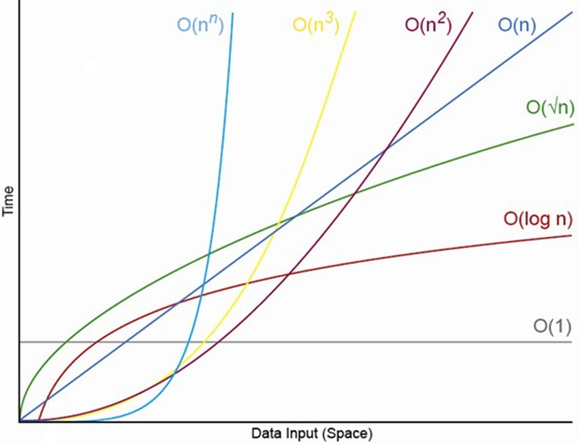
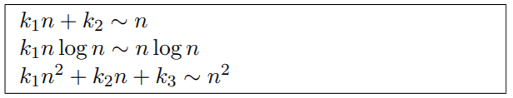
Growth Functions
We want to express rate of growth of a function:
The dominant term with respect to n.
Ignoring constants in front of it.
ALGORITHMS AND COMPLEXITY
Course Code: ALGOCOM

Slide 3
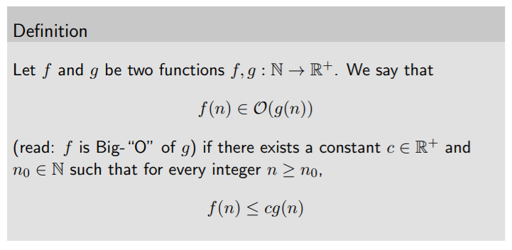
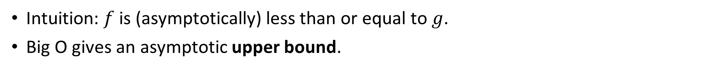
Big O or Asymptotic Upper Bound
Intuition: $f$ is (asymptotically) less than or equal to $g$.
Big O gives an asymptotic upper bound.
ALGORITHMS AND COMPLEXITY
Course Code: ALGOCOM

Slide 4
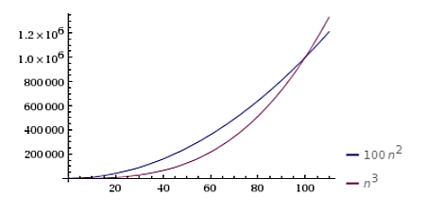

Big O
$f(n) ∈ O(g(n))$if $g(n)$ eventually dominates $f(n)$
Let $f(n) = 100n2$, $g(n) = n3$
For $n < 100, f(n) > g(n)$
At $n = 100, f(n) = g(n)$
For $n > 100, g(n) > f(n)$
ALGORITHMS AND COMPLEXITY
Course Code: ALGOCOM

Slide 5
Situational example
Suppose you’re using simple search to look for a user in your user database. You know that simple linear search takes O(n) time to run, which means in the worst case, you’re algorithm will have to look through every user in the database.
ALGORITHMS AND COMPLEXITY
Course Code: ALGOCOM

Slide 6
Constant Complexity: O(1)
A constant task’s run time won’t change no matter what the input value is.
So we can say the function runs in O(1) time; its run-time does not increase. Its order of magnitude is always 1.
Ex. swap(), print, return, initialize
read(x)
a = 10
a += 8
ALGORITHMS AND COMPLEXITY
Course Code: ALGOCOM

Slide 7

Linear Complexity: O(n)
A linear task’s run time will vary depending on it’s input value. Run time increases at an order of magnitude proportional to $n$.
Ex. single for loops, while loops
for (int i = 1; i <= n; i += c){
// some O(1) expressions
}
for (int i = n; i > 0; i -= c) {
// some O(1) expressions
}
ALGORITHMS AND COMPLEXITY
Course Code: ALGOCOM

Slide 8
Quadratic Complexity: O(n²)
A quadratic task requires a number of steps equal to the square of it’s input value.
Time complexity of nested loops is equal to the number of times the innermost statement is executed.
Ex. Nested for loops, nested while loops
for (int i = 1; i <= n; i += c) {
for (int j = 1; j <= k; j += c) { // some O(1) expressions
}
}
for (int i = n; i > 0; i -= c) {
for (int j = i+1; j <= k; j += c){ // some O(1) expressions
}
}
ALGORITHMS AND COMPLEXITY
Course Code: ALGOCOM

Slide 9
Logarithmic Complexity: O(log₂n)
This is the type of algorithm that makes computation blazingly fast.
Instead of increasing the time it takes to perform each subsequent step, the time is decreased at magnitude inversely proportional to n.
if the loop variables are divided / multiplied by a constant amount.
Ex. Binary search
for (int i = 1; i <=n; i *= c) {
// some O(1) expressions
}
for (int i = n; i > 0; i /= c) {
// some O(1) expressions
}
ALGORITHMS AND COMPLEXITY
Course Code: ALGOCOM

Slide 10

Exponential Complexity: O(2^{n})
Time complexity at an exponential rate means that with each step the function performs, it’s subsequent step will take longer by an order of magnitude equivalent to a factor of $n$.
Ex. travelling salesman
var fibonacci = function(number) { if (number <= 1) return number; return Fibonacci(number - 2) + Fibonacci(number - 1); };
ALGORITHMS AND COMPLEXITY
Course Code: ALGOCOM

Slide 11
To calculate Big O, there are five steps you should follow:
Break your algorithm/function into individual operations.
Calculate the Big O of each operation.
Add up the Big O of each operation together.
Remove the constants.
Find the highest order term — this will be what we consider the Big O of our algorithm/function.
ALGORITHMS AND COMPLEXITY
Course Code: ALGOCOM

Slide 12
Why do we only get the highest term?
Big O describes a growth regime, but it doesn't describe what we're observing growth in. Big O provides a generalized measure of run times.
We are usually not interested in exact running times, but only in an asymptotic classification of the running time, that ignores constant factors and constant additive offsets.
An exact analysis (e.g. exactly counting the number of operations in a RAM) may be hard, but wouldn’t lead to more precise results as the computational model is already quite a distance from reality.
Running time should be expressed by simple functions.
Note: When we are talking about algorithms, we try to describe their running time as precisely as possible.
ALGORITHMS AND COMPLEXITY
Course Code: ALGOCOM

Slide 13
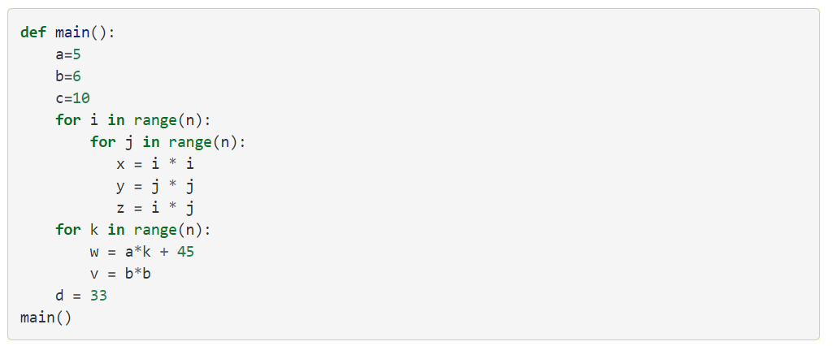
Guess the complexity
ALGORITHMS AND COMPLEXITY
Course Code: ALGOCOM

Slide 14
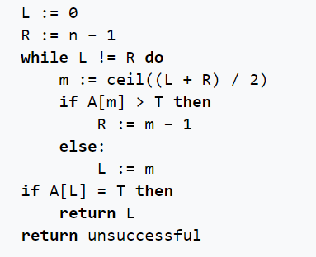
Guess the complexity
ALGORITHMS AND COMPLEXITY
Course Code: ALGOCOM

Slide 15
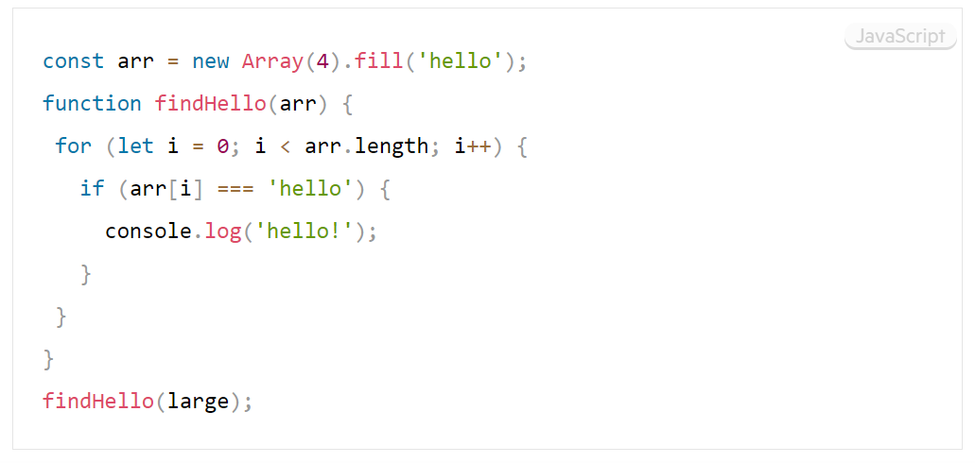
Guess the complexity
ALGORITHMS AND COMPLEXITY
Course Code: ALGOCOM

Slide 16
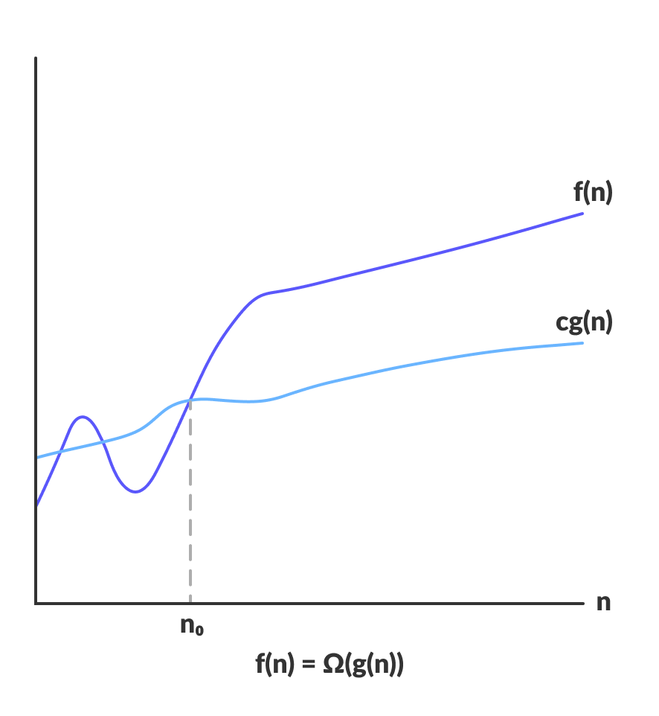
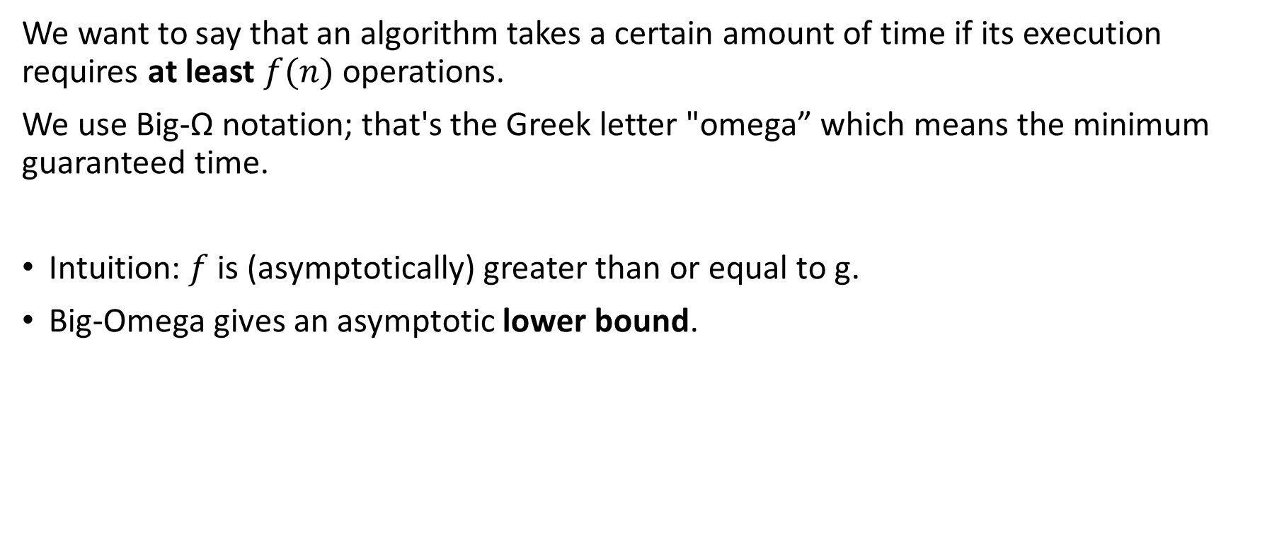
Big Omega Ω or Asymptotic Lower Bound
We want to say that an algorithm takes a certain amount of time if its execution requires at least $f(n)$ operations.
We use Big-Ω notation; that's the Greek letter "omega” which means the minimum guaranteed time.
Intuition: $f$ is (asymptotically) greater than or equal to g.
Big-Omega gives an asymptotic lower bound.
ALGORITHMS AND COMPLEXITY
Course Code: ALGOCOM

Slide 17
Example
For example, all algorithms have a trivial minimum computational time of Ω(0). Also, linear search has a best-case scenario of Ω(1), which happens if the element we’re searching is the first in the list.
If you really do have a million dollars in your pocket, you can truthfully say "I have an amount of money in my pocket, and it's at least 10 dollars." That is correct, but certainly not very precise.
Similarly, we can correctly but imprecisely say that the worst-case running time of binary search is Ω(1) because we know that it takes at least constant time.
ALGORITHMS AND COMPLEXITY
Course Code: ALGOCOM

Slide 18
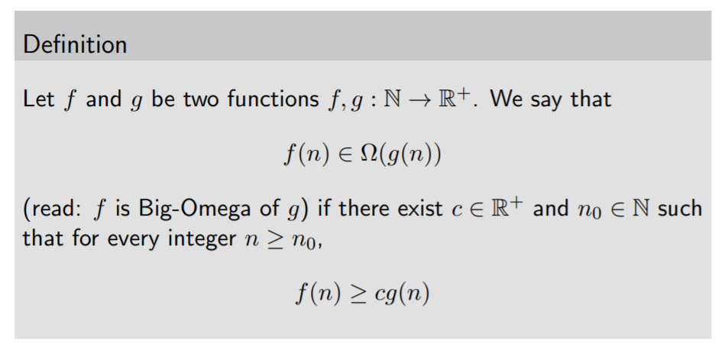
Big Omega Ω or Asymptotic Lower Bound
ALGORITHMS AND COMPLEXITY
Course Code: ALGOCOM

Slide 19
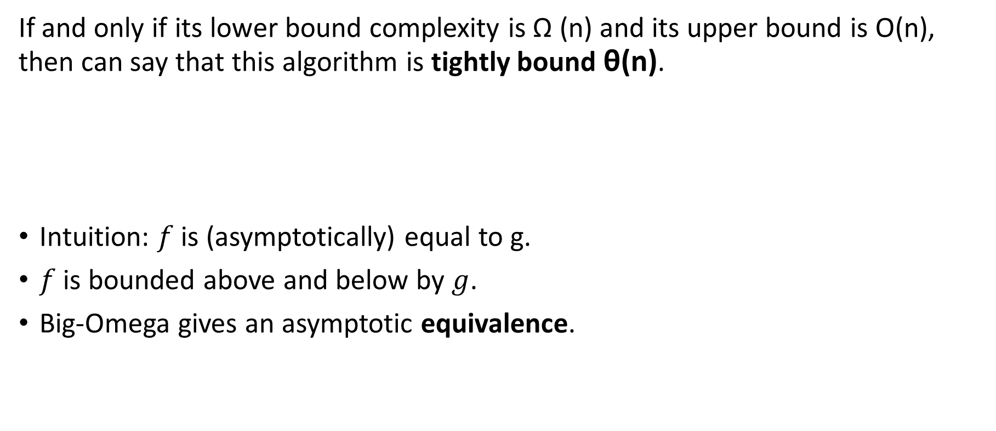
Big Theta θ or Asymptotic Tight Bound
If and only if its lower bound complexity is Ω (n) and its upper bound is O(n), then can say that this algorithm is tightly bound θ(n).
Intuition: $f$ is (asymptotically) equal to g.
$f$ is bounded above and below by $g$.
Big-Omega gives an asymptotic equivalence.
ALGORITHMS AND COMPLEXITY
Course Code: ALGOCOM

Slide 20
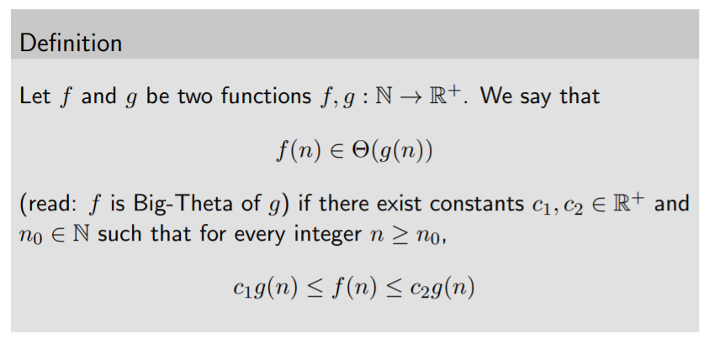
Big Theta θ or Asymptotic Tight Bound
ALGORITHMS AND COMPLEXITY
Course Code: ALGOCOM

Slide 21
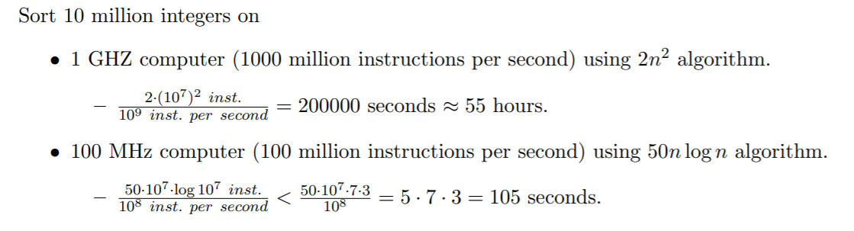
Analysis of algorithms matter!
ALGORITHMS AND COMPLEXITY
Course Code: ALGOCOM

Slide 22
Recursion
A phenomenon that occurs when a thing is defined in terms of itself or of its type. In programming context: a function that calls itself.
Methods exhibit recursive behavior when they can be defined by two properties:
A simple base case/s - a terminating scenario that does not use recursion to produce an answer.
A set of rules that reduce all other cases toward the base case.
ALGORITHMS AND COMPLEXITY
Course Code: ALGOCOM

Slide 23


Fibonacci sequence
1 1 2 3 5 8 13 21 …
The Fibonacci sequence is a classic example of recursion:
ALGORITHMS AND COMPLEXITY
Course Code: ALGOCOM

Slide 24
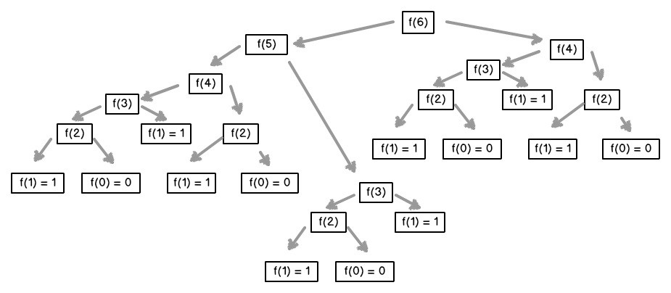
Fibonacci sequence
ALGORITHMS AND COMPLEXITY
Course Code: ALGOCOM

Slide 25
Recurrence Relations
A recurrence relation is an equation which is defined in terms of itself.
Many algorithms particularly divide and conquer algorithms have time complexities which are naturally modeled by recurrence relations.
Solving for recurrences or the closed form of recurrences can give the time complexity of divide and conquer algorithms.
Denoted as T(n)
TLDR: Recurrence relations are used to calculate for a recursive algorithm’s time complexity.
ALGORITHMS AND COMPLEXITY
Course Code: ALGOCOM

Slide 26
How to solve recurrence relations?
Establish recurrence conditions.
Iteratively unfold the recurrence until you see the pattern.
Get the closed form of the recurrence in terms of n.
Identify the complexity (in terms of Big O) of the closed form.
ALGORITHMS AND COMPLEXITY
Course Code: ALGOCOM

Slide 27
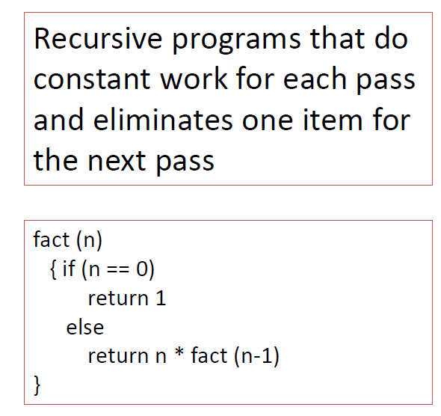
Recurrence relation 1
The time complexity of the recursion is O(n)
T(n) = T(n-1) + 1 n>0
T(0) = 0 n=0
k = 1
T(n) = T(n-1) + 1
k = 2
T(n) = (T(n-1)-1) + 1 + 1
Simplify
T(n) = T(n-2) + 2
T(n) = (T(n-1)-2) + 2 + 1
k = 3
Simplify
T(n) = T(n-3) + 3
Do you see a pattern? What is the normal form?
Make T(n-k) land on the base case by substitution
T(n) = T(n-k) + k
T(n) = T(n-n) + n
T(n) = 0 + n
n - k = 0
n = k
T(n) = T(0) + n
T(n) = n
ALGORITHMS AND COMPLEXITY
Course Code: ALGOCOM

Slide 28
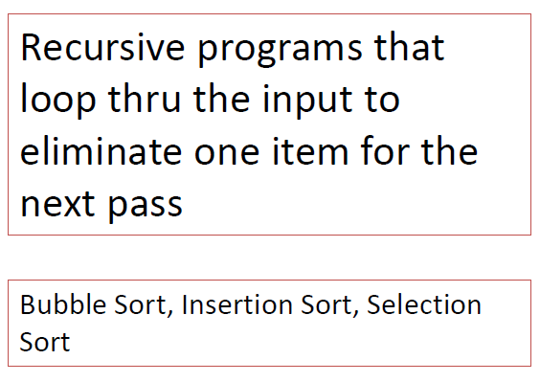
Recurrence relation 2
T(n) = T(n-1) + n n>0
T(0) = 1 n=0
k = 1
T(n) = T(n-1) + n
Simplify
k = 2
T(n) = (T(n-1)-1) + (n-1) + n
T(n) = T(n-2) + (n-1) + n
k = 3
T(n) = (T(n-2)-1) + (n-2) + (n-1) + n
Simplify
T(n) = T(n-3) + (n-2) + (n-1) + n
Do you see a pattern? What is the normal form?
T(n) = T(n-k) + (n-(k-1)) + (n-(k-2)) +…+ n
n-k=0
n=k
T(n) = T(n-n) + (n-(n-1)) + (n-(n-2)) +…+ n
ALGORITHMS AND COMPLEXITY
Course Code: ALGOCOM

Slide 29
Recurrence relation 2
The time complexity of the recursion is O(n²)
T(n) = T(n-1) + n n>0
T(0) = 1 n=0
Do you see a pattern? What is the normal form?
T(n) = T(n-k) + (n-(k-1)) + (n-(k-2)) +…+ n
T(n) = T(n-n) + (n-n+1) + (n-n+2) +…+ n
T(n) = T(0) + 1 + 2 +…+ n
T(n) = 1 + 2 +…+ n
Sum of natural numbers
T(n) = n(n+1)/2
Expand
T(n) = (n²+n)/2
Get highest term
T(n) = O(n²)
ALGORITHMS AND COMPLEXITY
Course Code: ALGOCOM

Slide 30
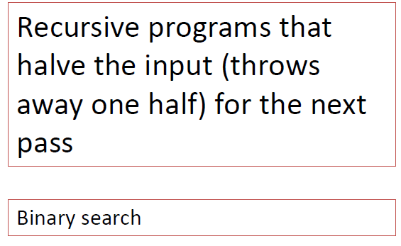
Recurrence relation 3
The time complexity of the recursion is O(log n)
k = 1
T(n) = T(n/2) + 1
k = 2
T(n) = T((n/2)/2) + 1 + 1
Simplify
T(n) = T(n/4) + 2
k = 3
T(n) = T((n/2)/4) + 2 + 1
Simplify
T(n) = T(n/8) + 3
Do you see a pattern? What is the normal form?
T(n) = T(n/2) + 1 n>1
T(1) = 1 n=1
T(n) = T(n/2^{k}) + k
n/2^{k} = 1
k = log n
Make T(n/2^{k}) land on the base case by substitution
T(n) = T(1) + log n
T(n) = log n
O(log n)
ALGORITHMS AND COMPLEXITY
Course Code: ALGOCOM

Slide 31
Your turn ☺
T(n) = T(n-1) + 2n n>0
T(0) = 1 n=0
ALGORITHMS AND COMPLEXITY
Course Code: ALGOCOM

